Slide 1
Vehicle Park Management System
Simplify Parking, Maximize Convenience.

Slide 2
Vehicle Park Management System
Problem Statement
Introduction
A vehicle park management system is a comprehensive software solution designed to manage vehicle parking facilities efficiently.
The systems initial purpose is to simplify the process of managing vehicles parked under a large organization.
Simplify Parking, Maximize Convenience.

Slide 3
Initialization and Configuration
Introduction
Problem Statement
The open source system provided managed to perform its base operations effectively but it fell short in these areas:
Old and Cluttered user interface.
Limited Search Functionality.
Unreliable report generation system.
Minor problems in overall user experience.

Slide 4
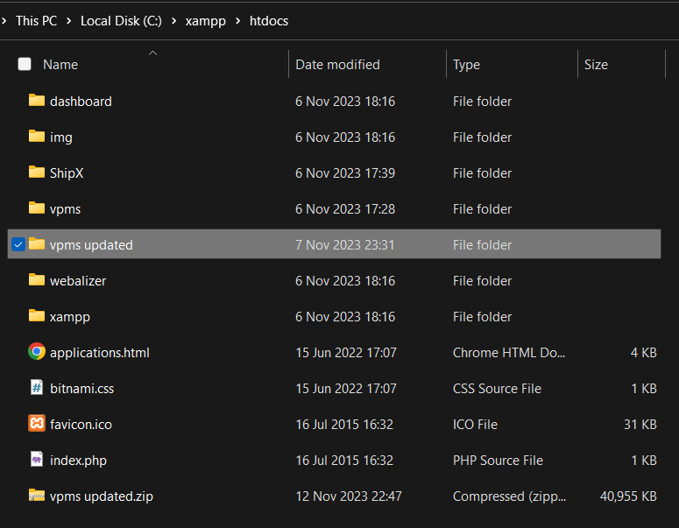
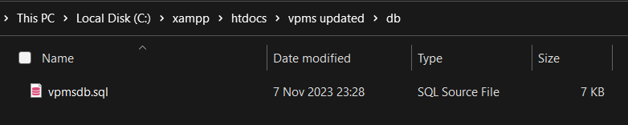
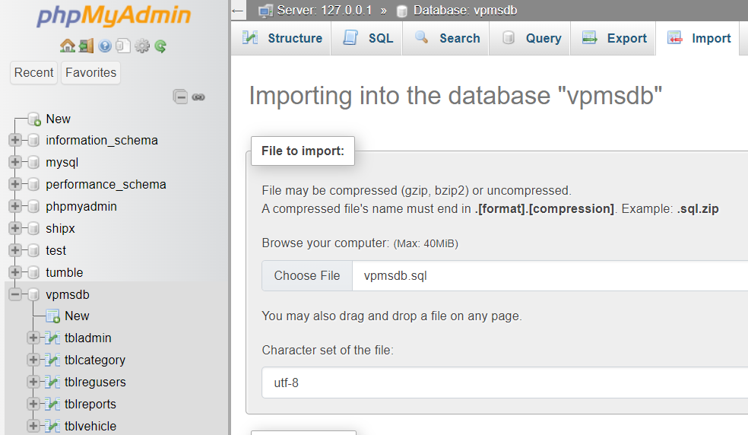
Problem Statement
Initialization and Configuration
Before diving into the system, let’s explain briefly how to startup the system.
Firstly, extract the project file into the “C:\xampp\htdocs” folder.
Secondly, launch “XAMPP”, create a database named “vpmsdb” and import the sql file inside the db folder.
Lastly, visit the site at “http://localhost/vpms%20updated/”

Slide 5
User Requirements
Before diving into the system, let’s explain briefly how to startup the system.
Initialization and Configuration
Firstly, extract the project file into the “C:\xampp\htdocs” folder.
Business Requirements
Secondly, launch “XAMPP”, create a database named “vpmsdb” and import the sql file inside the db folder.
Lastly, visit the site at “http://localhost/vpms%20updated/”

Slide 6
Functional Requirements
User Requirements
The user requirements are as stated below:
The system should provide information to the user in a simple and uncluttered manner.
Different levels of access should be allowed the users depending on their user roles.
Admins should have access to all the functionalities while regular users be limited to information on their profile.
Users should be able to logout and new users can create accounts seamlessly.

Slide 7
Non-Functional Requirements
User Requirements
Functional Requirements
The functional requirements are as stated below:
Users should be allowed to sign up for the system and login once they have an existing account.
Users should be able to reset their passwords.
Users can view their profile and update any necessary information.
The system should provide improved search functionalities.
The system should provide a detailed report for every action in the system.
The system should allow admins manage all types of vehicles under the system.

Slide 8
Functional Requirements
Non-Functional Requirements
The non-functional requirements are as stated below:
The system should respond to user interactions within 2 seconds.
Report generation should not take more then 10 seconds.
The system should be easy to navigate for new users.
Deliverables

Slide 9
Deliverables & Improved Features
Non-Functional Requirements
Deliverables

Slide 10
Deliverables & Improved Features
Updated system software with a minimalist user interface.
Advanced search functionalities.
Detailed report generation system.
Minor additional changes.

Slide 11
Deliverables & Improved Features
THANK YOU 👌

